Slide 1
“Water borne diseases detection in a particular location”
PIP104 PROFESSIONAL PRACTICE-II
VIVA-VOICE
Batch Number: CSD035
ROLL NO 20201CAI0194 20201CAI0184 20201CAI0189 20201CAI0191
STUDENT NAME NIHARIKA N LAD ARYA M R NIKHITHA V MANISHA G
Under the Supervision of,
Dr C Komalavalli
School of Computer Science & Engineering
Presidency University

Slide 2
Introduction
In today's rapidly changing world, access to clean and safe water is vital to the well-being of any community. Waterborne diseases pose a significant threat, and understanding their presence in our local area is crucial for safeguarding public health. That's where our project comes in
Our project is not just an website; it's a community-driven initiative to protect our neighbors and loved ones from waterborne diseases. We're on a mission to provide you with the knowledge and resources you need to make informed decisions about your water quality . our website provides a proper information about break down of water borne diseases in a particular location and helps in detecting it for the communities safety.

Slide 3
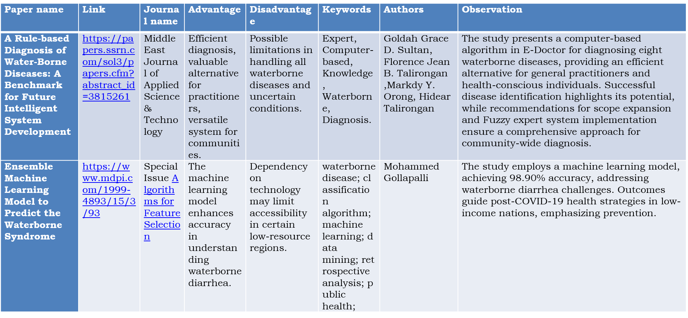
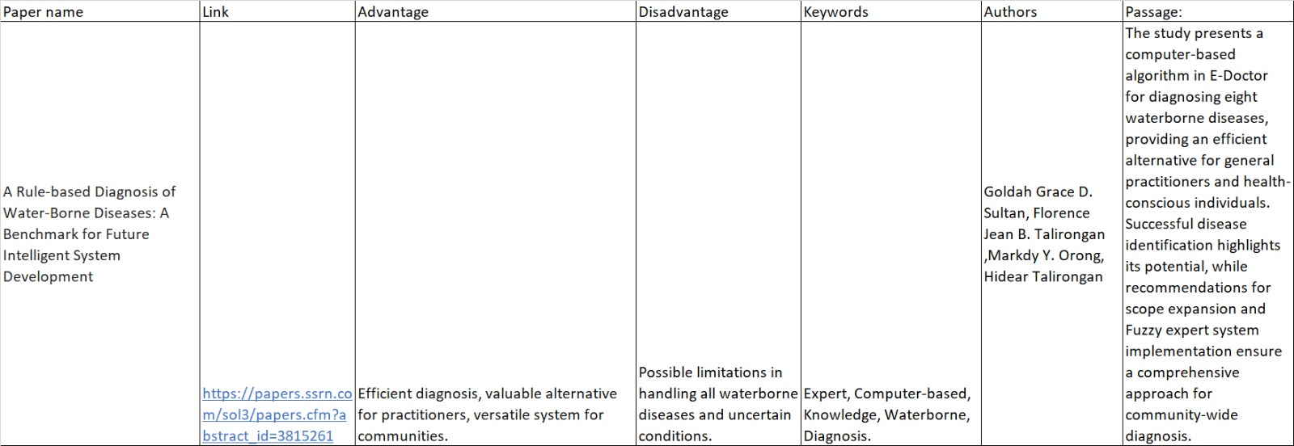
Literature Review

Slide 4
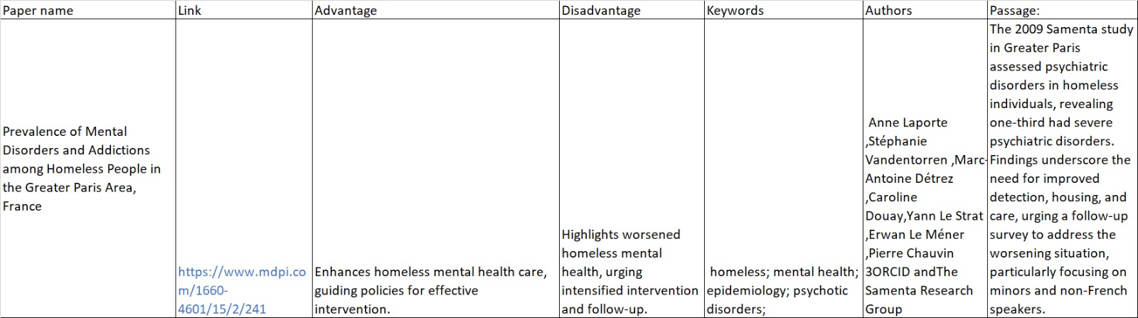
Literature Review

Slide 5
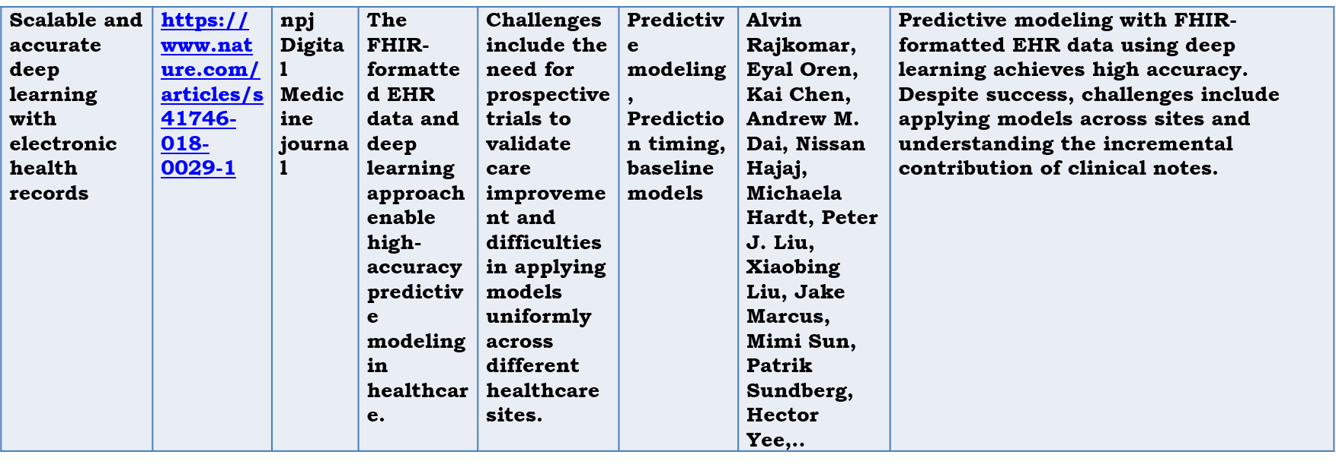
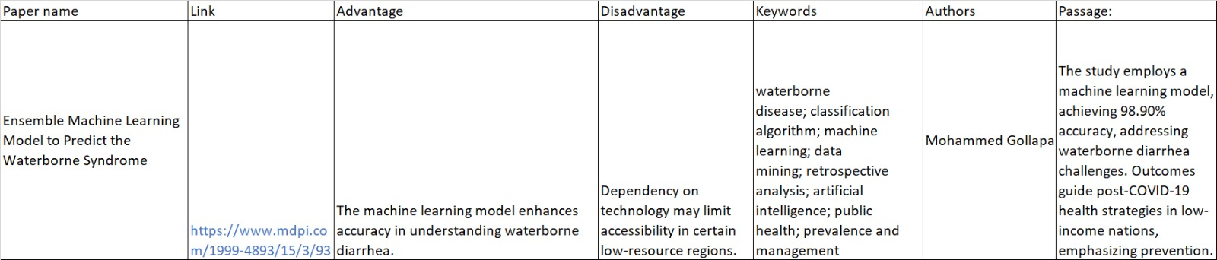
Literature Review

Slide 6
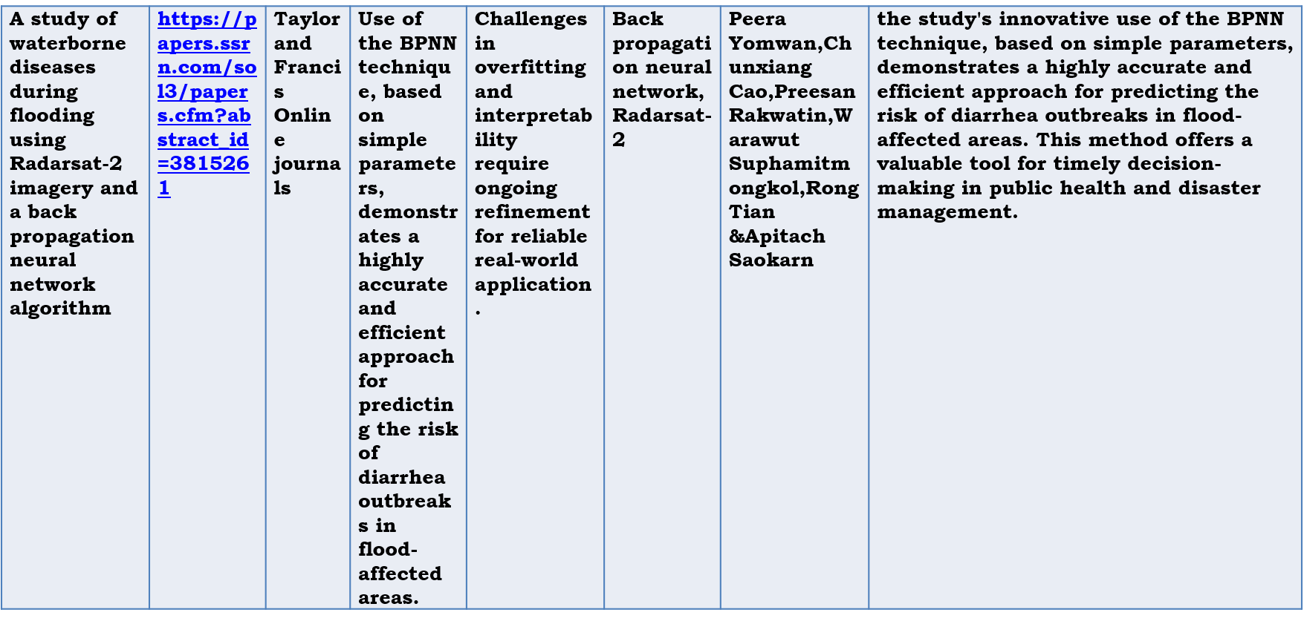
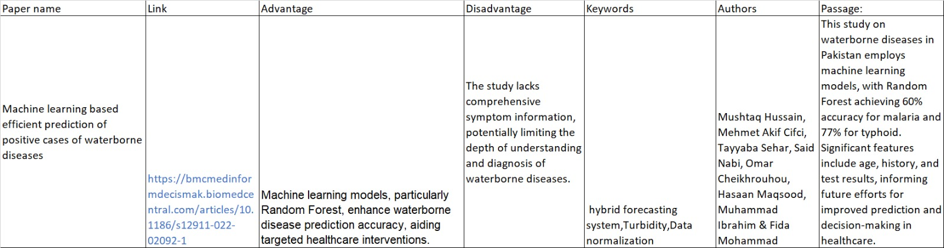
Literature Review

Slide 7
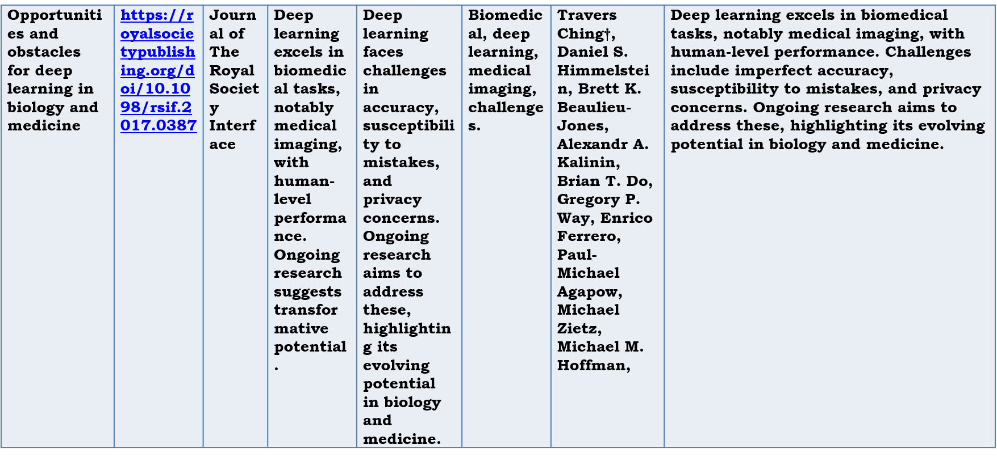
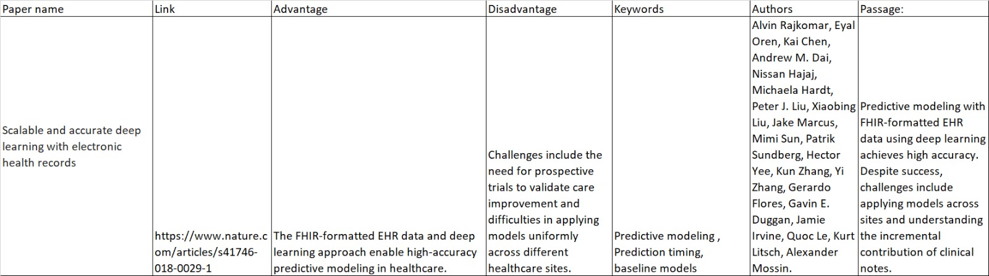
Literature Review

Slide 8
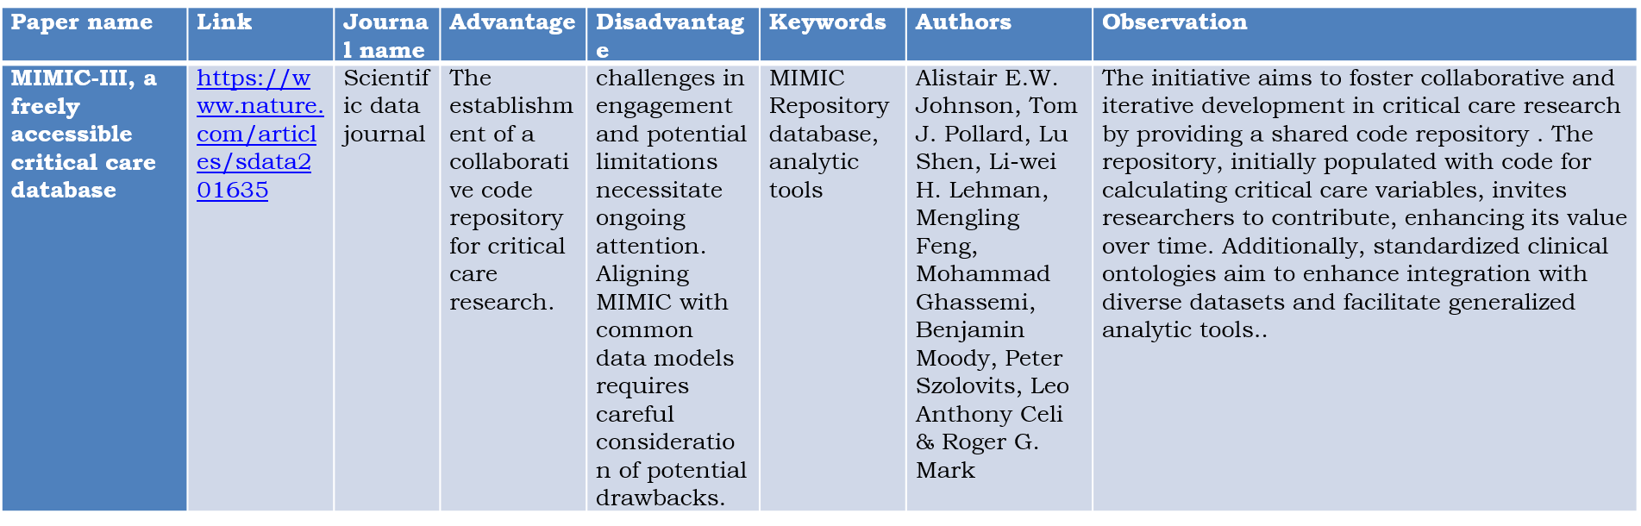
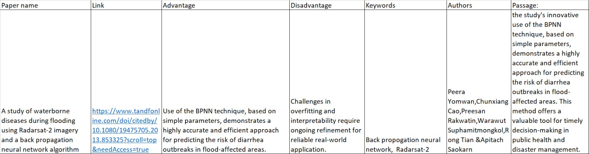
Literature Review

Slide 9
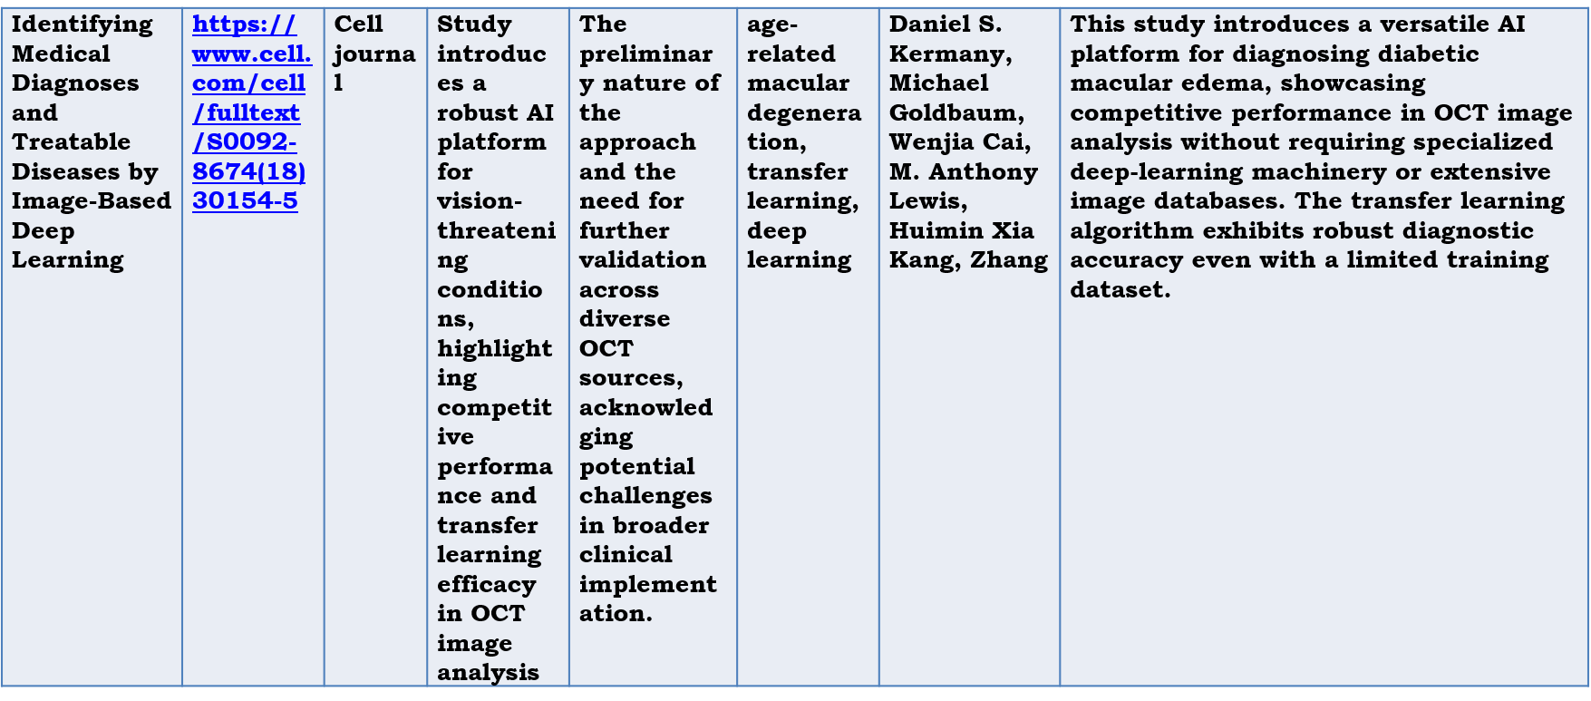
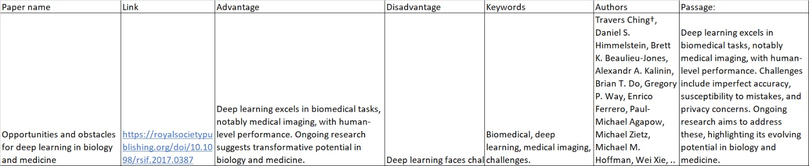
Literature Review

Slide 10
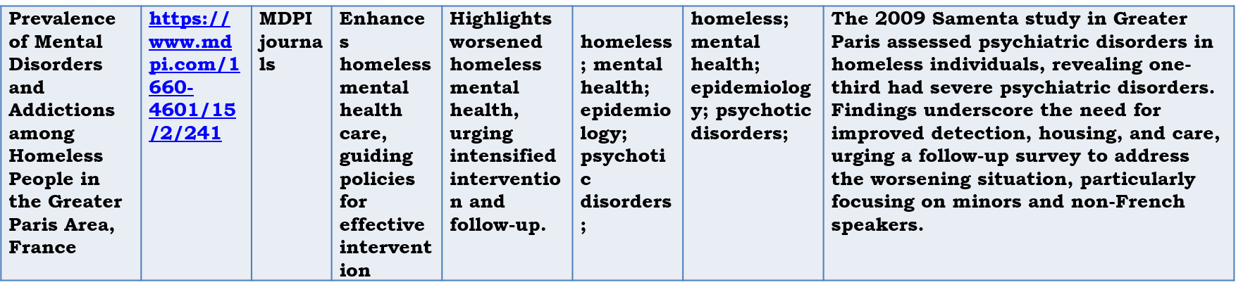
Literature Review

Slide 11
Reasearch Gaps Identified
Significant strides have been made in waterborne disease diagnosis through computer-based algorithms and machine learning models. A study showcases the potential of E-Doctor's algorithms in diagnosing eight waterborne diseases, emphasizing the need for further investigation into fuzzy logic integration. Another study achieves high accuracy in diagnosing diarrheal diseases and recommending health strategies, highlighting the importance of assessing their effectiveness in resource-limited settings. Machine learning models predicting malaria and typhoid in Pakistan reveal the need for improved accuracy and expanded factors in model development. Predicting drinking water quality using machine learning requires exploration of scalability and adaptability in diverse contexts.
While deep learning in Electronic Health Record (EHR) data is successful, challenges in model generalizability across different clinical settings persist. Ensuring the security and integrity of deep learning in healthcare is an ongoing concern. Collaborative initiatives in critical care research need evaluation for long-term impact and sustainability. A multidisciplinary AI platform for diabetic macular edema diagnosis prompts further exploration for other specific conditions. Lastly, mental health issues among the homeless underscore the necessity for collaborative strategies in testing, housing, and care. Closing these research gaps will enhance diagnostic accuracy and promote comprehensive healthcare solutions.

Slide 12
Proposed Methodology
Water Quality Sensors: Integrate sensors that measure key parameters such as pH, turbidity, and chlorine levels in the water. These sensors can provide real-time data for analysis.
GIS websiteing: Use Geographic Information System (GIS) technology to map water sources, contamination incidents, and affected areas. This helps in visualizing spatial patterns and trends.
Machine Learning Algorithms: Implement machine learning models to analyze historical data and identify patterns associated with waterborne diseases. This can enhance the website's predictive capabilities.
User Reporting: Allow users to report water quality issues through the website. Incorporate a user-friendly interface for submitting details like location, symptoms, and pictures, which can aid in quick response.
Data Fusion: Combine data from various sources, including sensors, weather conditions, and health records, to provide a comprehensive analysis of potential disease outbreaks.
Push Notifications: Implement an alert system to notify users and authorities about potential waterborne disease risks based on the website's analysis. Timely alerts can facilitate preventive measures.

Slide 13
Proposed Methodology
Water Source Monitoring: Regularly monitor and update information about different water sources in the location, including wells, rivers, and reservoirs. This helps in tracking changes in water quality over time.
Community Engagement: Foster community involvement by providing educational content on water hygiene, best practices, and the importance of reporting issues. Engaged communities can contribute valuable information.
Integration with Health Records: Collaborate with healthcare systems to integrate waterborne disease cases into health records. This integration can enhance the accuracy of disease tracking.
Collaboration with Authorities: Establish partnerships with local health departments and environmental agencies. Sharing data and collaborating on response strategies can improve the overall effectiveness of the website. Remember to ensure user privacy, data security, and compliance with relevant regulations when developing and deploying such websites.

Slide 14
Objectives
In regions where access to healthcare facilities is limited, mobile health websitelications powered by AI play a crucial role. These websites can educate individuals about waterborne diseases, provide early symptom detection tools, and offer guidance on seeking websiteropriate medical care. Furthermore, they can help track an individual's health status and share anonymized data with health authorities to aid in disease monitoring . The primary objective of the proposed website for monitoring and tracking waterborne diseases, as well as other diseases like dengue, malaria, jaundice, and tuberculosis , is to enhance public health and disease surveillance efforts.

Slide 15
Objectives
Here are the key objectives:
1.Early Disease Detection
2.Location Mwebsiteing
3.Data Aggregation
4.Data Sharing
5.Real-time Alerts
6.Public Engagement
7.Data Analysis
8.Scalability
9.Continuous improvements
10.Public Awareness
outcome:
Overall, the outcome of the website's implementation is a more responsive, data-driven, and effective public health system that can proactively address and mitigate the impact of waterborne and vector-borne diseases, leading to improved public health and well-being.

Slide 16
Timeline of Project

Slide 17
Expected Outcomes
An aggregation website that monitors the outbreak of waterborne diseases would have a significant impact on public health. By making it mandatory for test labs to report detected cases to the website, the website would create a real-time database of waterborne disease outbreaks. This information would be invaluable to various agencies, such as public health departments and water utilities, who could use it to take corrective action and prevent the spread of disease.
Here are some of the specific outcomes of this website: Reduced incidence of waterborne diseases:
By enabling early detection and response to outbreaks, the website could help to reduce the number of people who get sick from waterborne diseases.
Improved public health surveillance: The website would provide a valuable source of data on waterborne disease outbreaks, which could be used to improve public health surveillance and identify trends in disease incidence.
More effective outbreak response: The website would make it easier for public health departments and other agencies to respond to outbreaks by providing them with real-time information about the location and severity of outbreaks.
Reduced healthcare costs: By preventing the spread of disease, the website could help to reduce healthcare costs.

Slide 18
Expected Outcomes
In addition to these specific outcomes, the website would also have a number of other benefits, such as:
Increased public awareness of waterborne diseases: The website could help to raise public awareness of waterborne diseases and the importance of taking steps to prevent them.
Empowerment of communities: The website could empower communities to take action to protect their health by providing them with information about waterborne disease outbreaks in their area.
Improved water quality: The website could help to improve water quality by providing water utilities with information about waterborne disease outbreaks, which could help them to identify and address problems with their water treatment systems.
Overall, an aggregation website that monitors the outbreak of waterborne diseases would be a valuable tool for improving public health. The website could help to reduce the incidence of waterborne diseases, improve public health surveillance, and make outbreak response more effective.

Slide 19
Conclusion
The development of an aggregation website to monitor the outbreak of waterborne diseases holds immense potential for enhancing public health and safety. By facilitating real-time data collection and dissemination, this website could revolutionize the way we detect, track, and respond to waterborne disease outbreaks. The website's mandatory reporting feature for test labs would create a comprehensive and up-to-date database of waterborne disease cases, providing invaluable insights to public health authorities and water utilities. This real-time information would enable swift identification of outbreak hotspots, allowing for timely interventions to prevent further spread.
The website's location-based reporting functionality would provide a clear picture of the geographical distribution of waterborne diseases, enabling targeted interventions and resource allocation. This spatial data could also inform preventive measures, such as targeted water quality testing and community awareness campaigns. Furthermore, the website's cloud-based data repository would facilitate collaboration among various stakeholders, including public health agencies, water utilities, and community organizations.

Slide 20
CONCLUSION
This collaborative websiteroach would streamline outbreak response efforts and ensure that resources are deployed effectively. The cumulative impact of this website on public health could be substantial. By reducing the incidence of waterborne diseases, the website could save lives and alleviate healthcare burdens. It could also empower communities by providing them with real-time information about outbreaks in their neighborhoods, enabling them to take proactive measures to protect their health. In conclusion, the proposed aggregation website for monitoring waterborne disease outbreaks represents a significant step forward in public health technology. Its potential to improve disease detection, enhance outbreak response, and empower communities makes it a valuable investment in public health and safety.

Slide 21
References
[1] A Rule-based Diagnosis of Water-Borne Diseases: A Benchmark for Future Intelligent System Development
Link: https://papers.ssrn.com/sol3/papers.cfm?abstract_id=3815261
Authors: Goldah Grace D. Sultan, Florence Jean B. Talirongan, Markdy Y. Orong, Hidear Talirongan
[2] Ensemble Machine Learning Model to Predict the Waterborne Syndrome
Link: https://www.mdpi.com/1999-4893/15/3/93
Author: Mohammed Gollapalli
[3] Machine learning based efficient prediction of positive cases of waterborne diseases
Link: https://bmcmedinformdecismak.biomedcentral.com/articles/10.1186/s12911-022-02092-1
Authors: Mushtaq Hussain, Mehmet Akif Cifci, Tayyaba Sehar, Said Nabi, Omar Cheikhrouhou, Hasaan Maqsood, Muhammad Ibrahim & Fida Mohammad
[4] The Quality of Drinkable Water using Machine Learning Techniques
Link:https://www.researchgate.net/publication/361118196_The_Quality_of_Drinkable_Water_using_Machine_Learning_Techniques
Author: Osim Kumar Pal

Slide 22
References
[5]Scalable and accurate deep learning with electronic health records
Link: https://www.nature.com/articles/s41746-018-0029-1
Authors: Alvin Rajkomar, Eyal Oren, Kai Chen, Andrew M. Dai, Nissan Hajaj, Michaela Hardt, Peter J. Liu, Xiaobing Liu, Jake Marcus, Mimi Sun, Patrik Sundberg, Hector Yee,.
[6]A study of waterborne diseases during flooding using Radarsat-2 imagery and a back propagation neural network algorithm
Link: https://papers.ssrn.com/sol3/papers.cfm?abstract_id=3815261
Authors: Peera Yomwan, Chunxiang Cao, Preesan Rakwatin, Warawut Suphamitmongkol, Rong Tian &Apitach Saokarn
[7] Opportunities and obstacles for deep learning in biology and medicine
Link: https://royalsocietypublishing.org/doi/10.1098/rsif.2017.0387
Authors: Travers Ching†, Daniel S. Himmelstein, Brett K. Beaulieu-Jones, Alexandr A. Kalinin, Brian T. Do, Gregory P. Way, Enrico Ferrero, Paul-Michael Agapow, Michael Zietz, Michael M. Hoffman,.
[8] MIMIC-III, a freely accessible critical care database
Link: https://www.nature.com/articles/sdata201635
Authors: Alistair E.W. Johnson, Tom J. Pollard, Lu Shen, Li-wei H. Lehman, Mengling Feng, Mohammad Ghassemi, Benjamin Moody, Peter Szolovits, Leo Anthony Celi & Roger G. Mark

Slide 23
References
[9] Identifying Medical Diagnoses and Treatable Diseases by Image-Based Deep Learning
Link: https://www.cell.com/cell/fulltext/S0092-8674(18)30154-5
Authors: Daniel S. Kermany, Michael Goldbaum, Wenjia Cai, M. Anthony Lewis, Huimin Xia Kang, Zhang
[10] Prevalence of Mental Disorders and Addictions among Homeless People in the Greater Paris Area, France
Link: https://www.mdpi.com/1660-4601/15/2/241
Authors: Anne Laporte, Stéphanie Vandentorren ,Marc-Antoine Détrez, Caroline Douay, Yann Le Strat, Erwan Le Méner, Pierre Chauvin
[11] Artificial Intelligence in Healthcare: AI, Machine Learning, and Deep and Intelligent Medicine Simplified for Everyone
Author: Parag Mahajan
Publisher: Parag Suresh Mahajan, 2018
[12] HealthClinicz.biz by Microsoft
Link: https://github.com/microsoft/HealthClinic.biz
Source: GitHub

Slide 24
Publication Details
The research article titled "Water Borne Disease Detection in a Particular Location" delves into the intricacies of identifying and combating waterborne illnesses within a specific region. Authored by Niharika N Lad , Arya M R ,Nikhitha V and Manisha G the paper website ears in the December 2023 issue of the International Research Journal of Modernization in Engineering Technology and Science, occupying pages 1800 of Volume 5. This esteemed journal boasts a robust impact factor of 7.868, signifying its significant contribution to the scientific community. Through their meticulous analysis, Lad and Arya shed light on innovative methods for pinpointing waterborne disease outbreaks, potentially safeguarding public health in vulnerable locations.
Link: https://www.irjmets.com/uploadedfiles/paper//issue_12_december_2023/47591/final/fin_irjmets1703255761.pdf

Slide 25
Thank You

